Slide 1
MODERN OPERATING SYSTEMS
Chapter 10
Case Study 1: LINUX
Tanenbaum, Modern Operating Systems 3 e, (c) 2008 Prentice-Hall, Inc. All rights reserved. 0-13-6006639

Slide 2
History of UNIX and Linux
UNICS
PDP-11 UNIX
Portable UNIX
Berkeley UNIX
Standard UNIX
MINIX
Linux
Tanenbaum, Modern Operating Systems 3 e, (c) 2008 Prentice-Hall, Inc. All rights reserved. 0-13-6006639

Slide 3
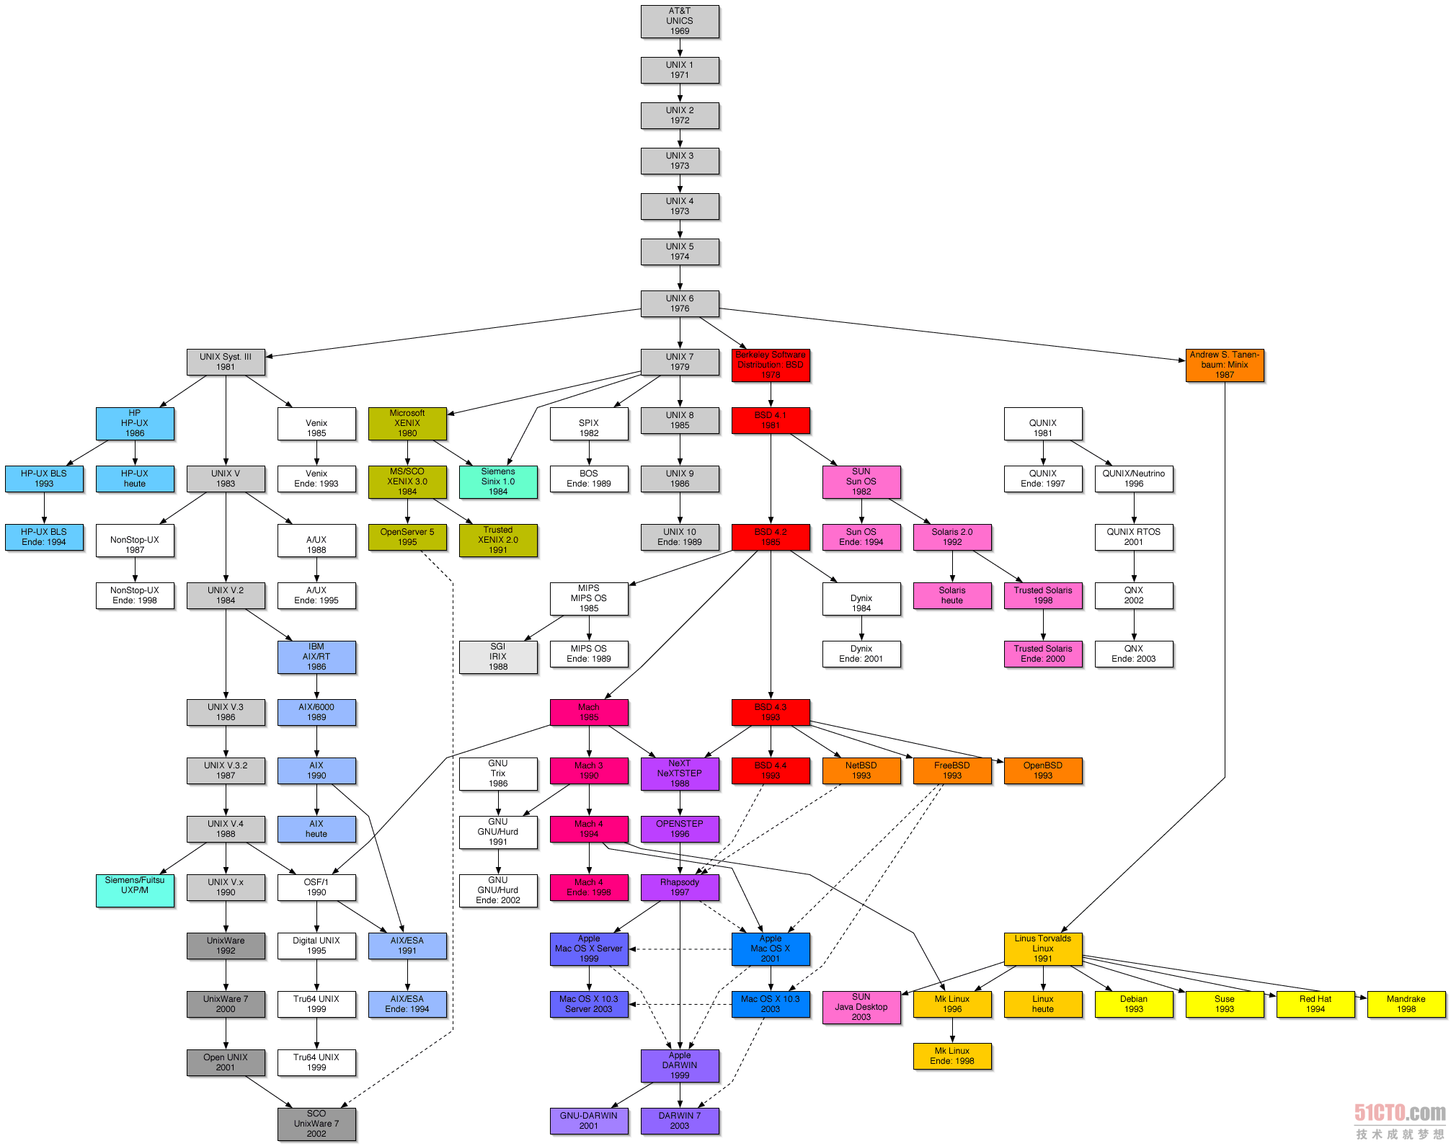
Tanenbaum, Modern Operating Systems 3 e, (c) 2008 Prentice-Hall, Inc. All rights reserved. 0-13-6006639

Slide 4
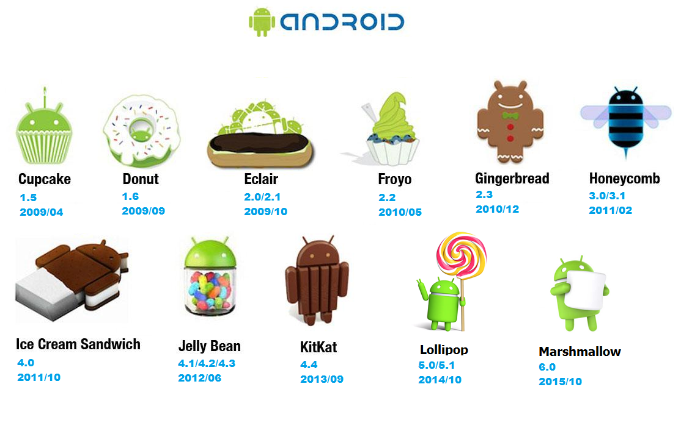




Nougat Oreo Pie Q
7.0 8.0 9.0 10.0
2016/03 2017/03 2018/03 2019/09
Tanenbaum, Modern Operating Systems 3 e, (c) 2008 Prentice-Hall, Inc. All rights reserved. 0-13-6006639

Slide 5
UNIX/Linux Goals
Designed by programmers, for programmers
Designed to be:
  Simple
  Elegant (精练的)
  Consistent
  Powerful
  Flexible
  ls A*
  rm A*
  --principle of least surprise
Tanenbaum, Modern Operating Systems 3 e, (c) 2008 Prentice-Hall, Inc. All rights reserved. 0-13-6006639

Slide 6
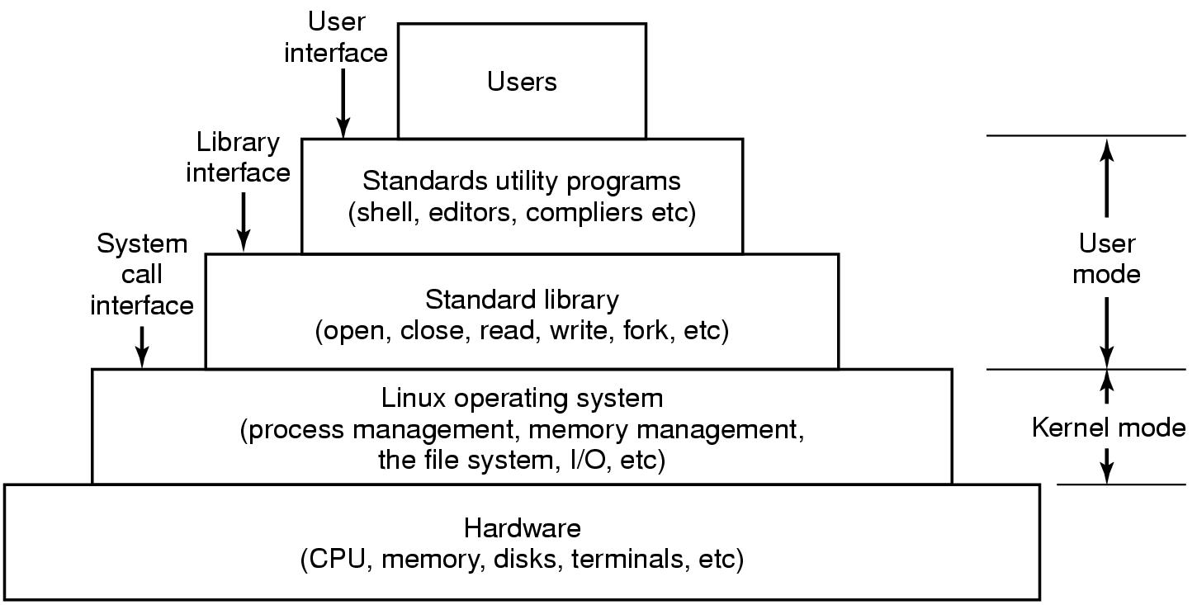
Interfaces to Linux
Figure 10-1. The layers in a Linux system.
Tanenbaum, Modern Operating Systems 3 e, (c) 2008 Prentice-Hall, Inc. All rights reserved. 0-13-6006639

Slide 7
Shell
A command-line interface
Much faster to use.
More powerful.
Easily extensible.
bash shell—default shell in most Linux systems.
Tanenbaum, Modern Operating Systems 3 e, (c) 2008 Prentice-Hall, Inc. All rights reserved. 0-13-6006639

Slide 8
Linux Utility Programs (1)
Categories of utility programs in the shell user interface to Linux:
File and directory manipulation commands.
Filters.
Program development tools, such as editors and compilers.
Text processing.
System administration.
Miscellaneous.
Tanenbaum, Modern Operating Systems 3 e, (c) 2008 Prentice-Hall, Inc. All rights reserved. 0-13-6006639

Slide 9
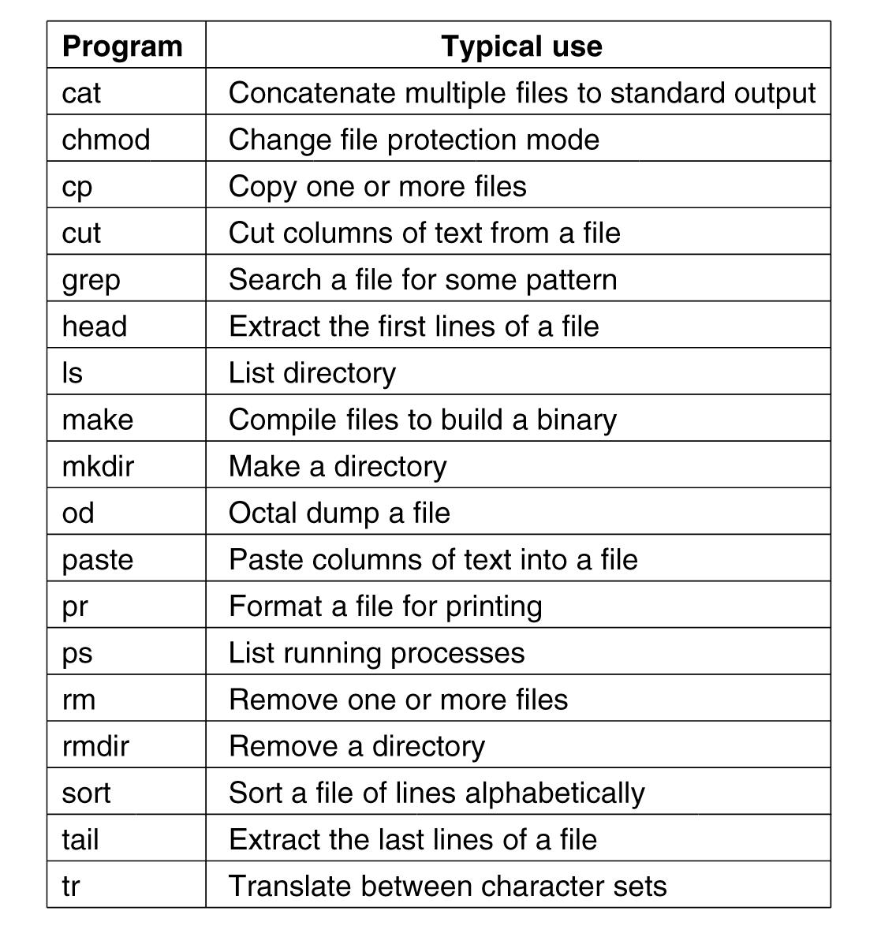
Linux Utility Programs (2)
Figure 10-2. A few of the common Linux utility programs required by POSIX.
Tanenbaum, Modern Operating Systems 3 e, (c) 2008 Prentice-Hall, Inc. All rights reserved. 0-13-6006639

Slide 10
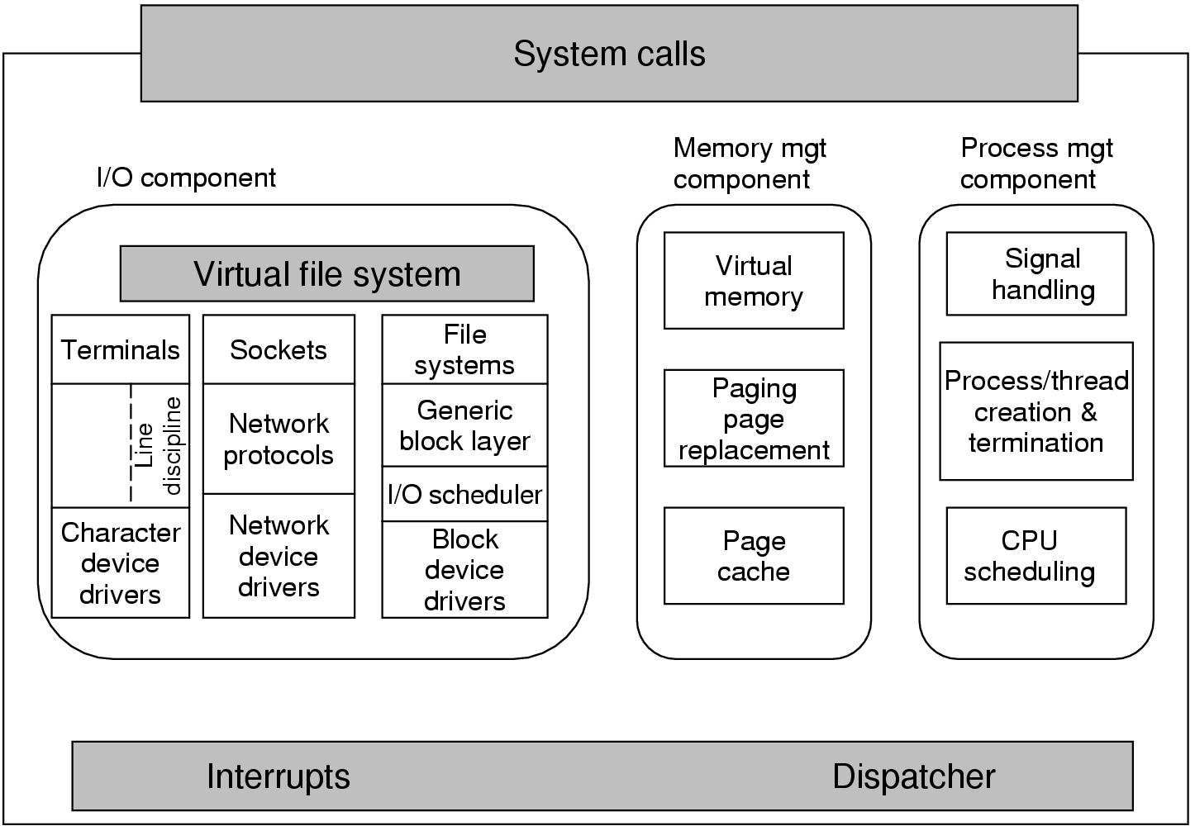
Kernel Structure
Figure 10-3. Structure of the Linux kernel
Tanenbaum, Modern Operating Systems 3 e, (c) 2008 Prentice-Hall, Inc. All rights reserved. 0-13-6006639

Slide 11
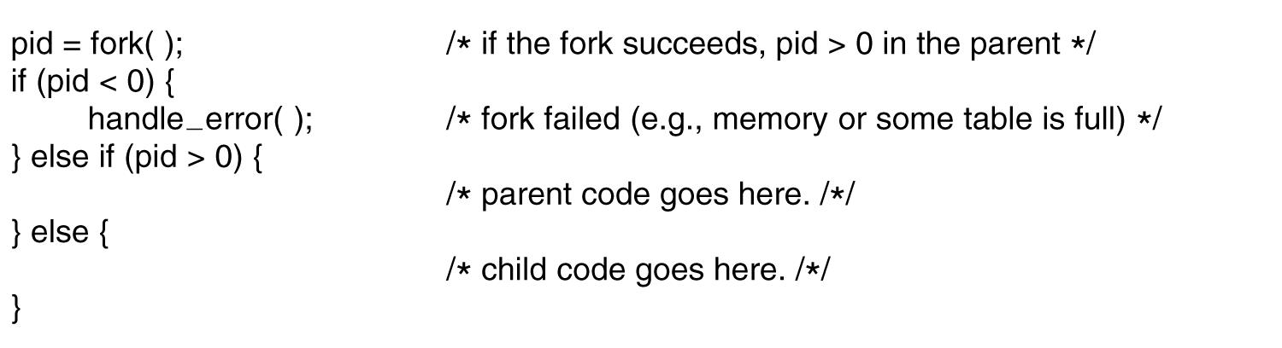
Processes in Linux
Linux, a multiprogramming system
Many independent processes running
fork system call creates process
Figure 10-4. Process creation in Linux.
Tanenbaum, Modern Operating Systems 3 e, (c) 2008 Prentice-Hall, Inc. All rights reserved. 0-13-6006639

Slide 12
Processes in Linux
Processes can communicate using message passing, like pipes
sort <f | head
Tanenbaum, Modern Operating Systems 3 e, (c) 2008 Prentice-Hall, Inc. All rights reserved. 0-13-6006639

Slide 13
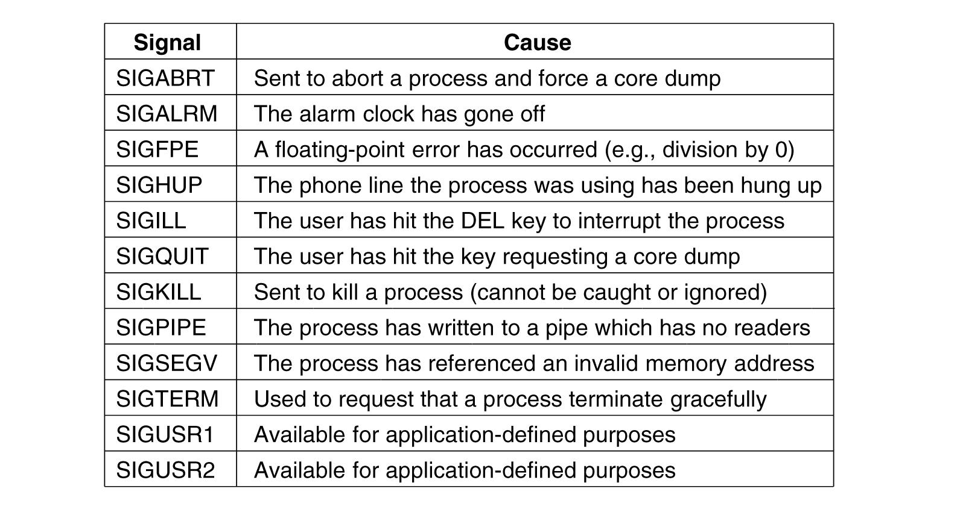
Processes in Linux
Processes can communicate using software interrupts, like signal
Tanenbaum, Modern Operating Systems 3 e, (c) 2008 Prentice-Hall, Inc. All rights reserved. 0-13-6006639

Slide 14
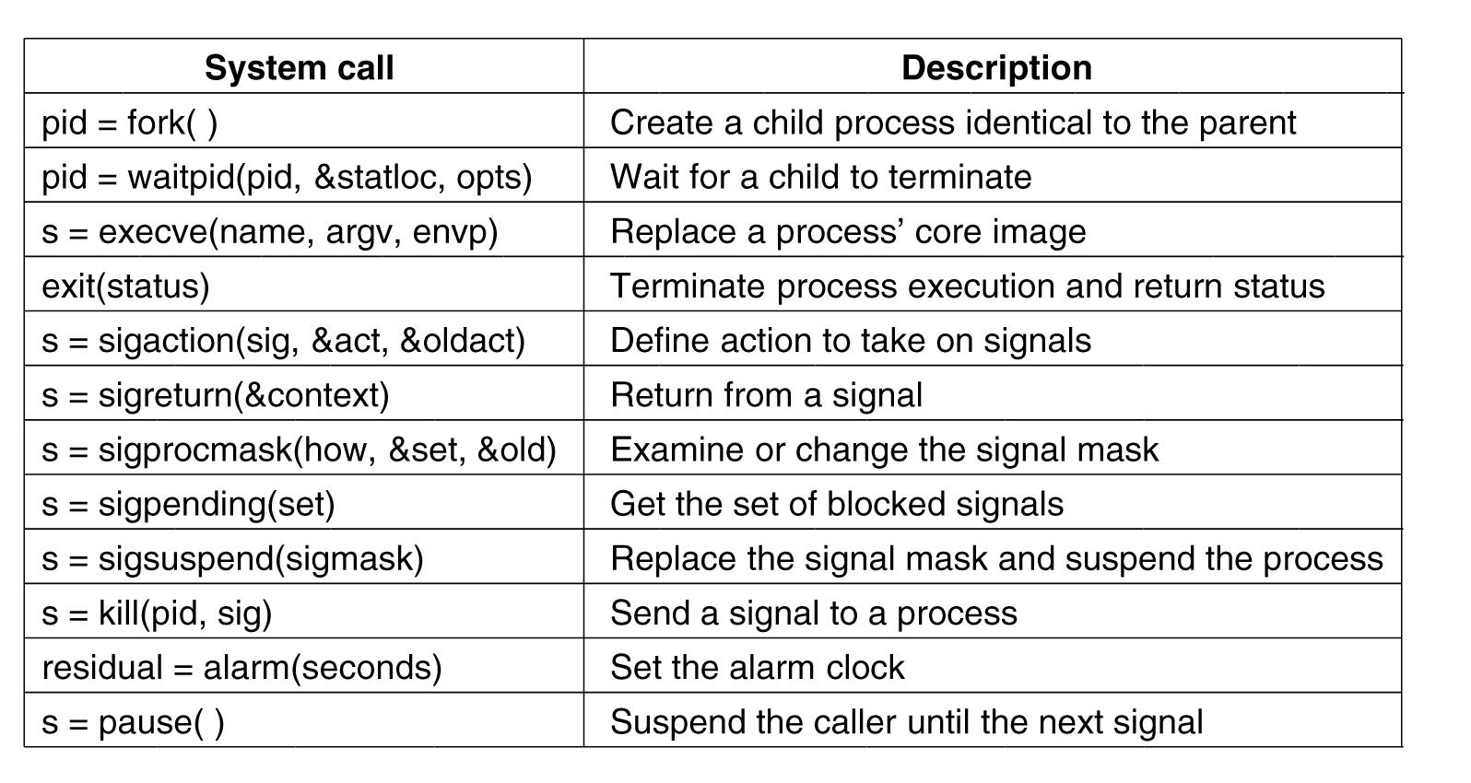
Process Management System Calls in Linux
Figure 10-6. Some system calls relating to processes.
Tanenbaum, Modern Operating Systems 3 e, (c) 2008 Prentice-Hall, Inc. All rights reserved. 0-13-6006639

Slide 15
Scheduling in Linux (1)
Linux threads are kernel threads, so scheduling is based on threads, not processes.
Three classes of threads for scheduling purposes:
Real-time FIFO.
Real-time round robin.
Timesharing.
Tanenbaum, Modern Operating Systems 3 e, (c) 2008 Prentice-Hall, Inc. All rights reserved. 0-13-6006639

Slide 16
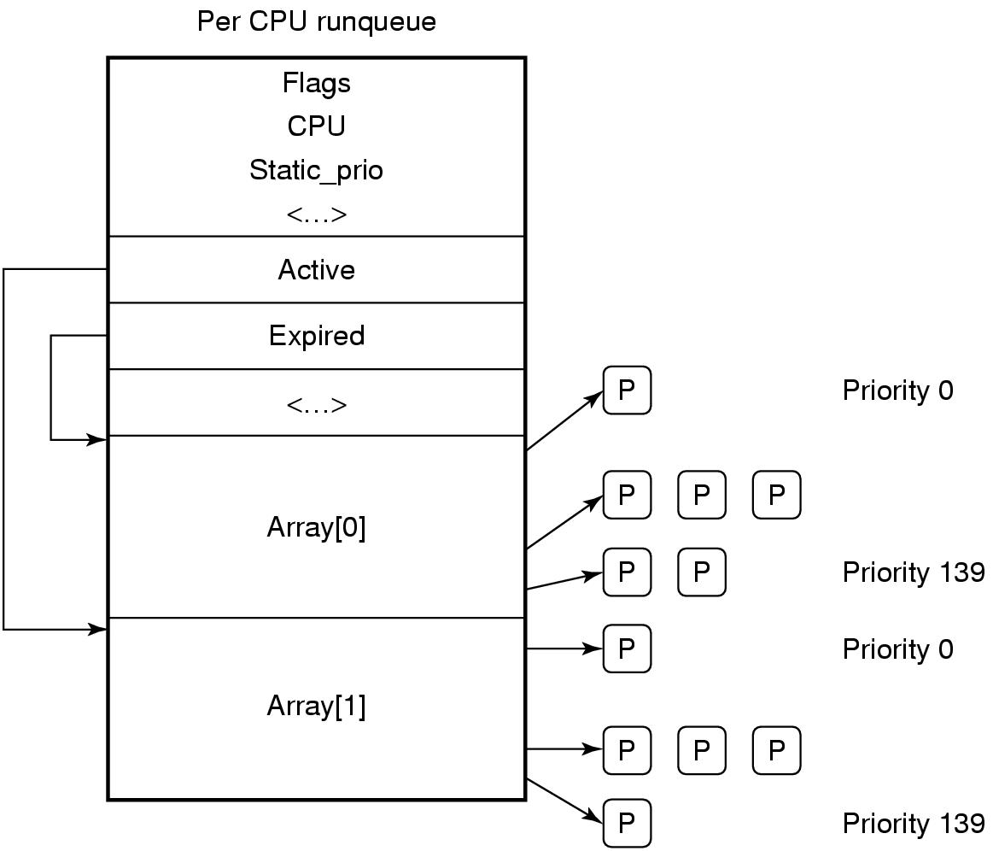
Scheduling in Linux (2)
A key data structure used by the Linux scheduler is a runqueue调度队列.
Figure 10-10. Illustration of Linux runqueue and priority arrays.
Tanenbaum, Modern Operating Systems 3 e, (c) 2008 Prentice-Hall, Inc. All rights reserved. 0-13-6006639

Slide 17
Booting Linux
Typical boot steps:
BIOS performs Power-On-Self-Test (POST) and initial device discovery and initialization.
MBR is read into a fixed memory location and executed, load boot program.
boot reads the root dir of the boot device (GRUB, LILO).
boot reads in the OS kernel and jumps to it.
Tanenbaum, Modern Operating Systems 3 e, (c) 2008 Prentice-Hall, Inc. All rights reserved. 0-13-6006639

Slide 18
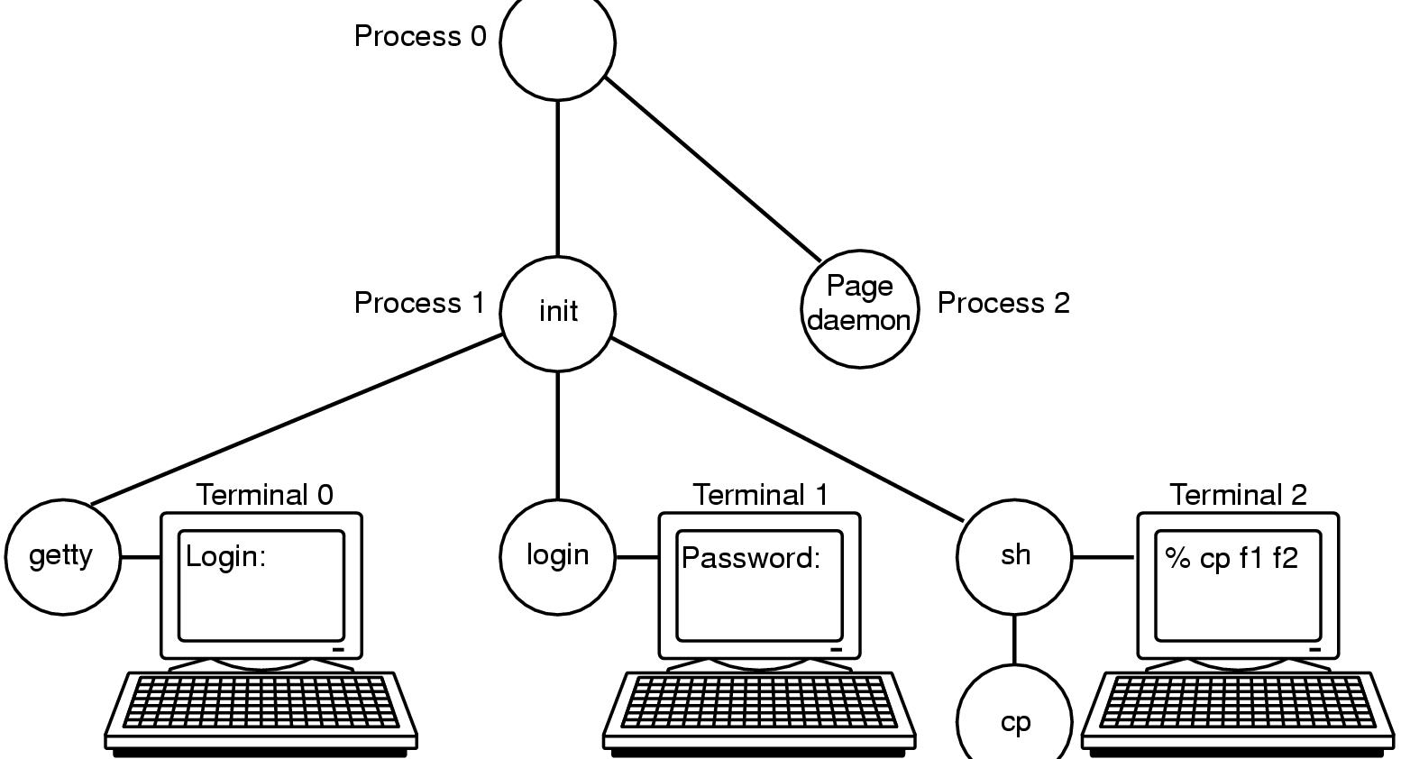
Booting Linux
Figure 10-11. The sequence of processes used to
boot some Linux systems.
Tanenbaum, Modern Operating Systems 3 e, (c) 2008 Prentice-Hall, Inc. All rights reserved. 0-13-6006639

Slide 19
Memory Management in Linux
Every Linux process has an address space logically consisting of three segments:
text
data
stack
Tanenbaum, Modern Operating Systems 3 e, (c) 2008 Prentice-Hall, Inc. All rights reserved. 0-13-6006639

Slide 20
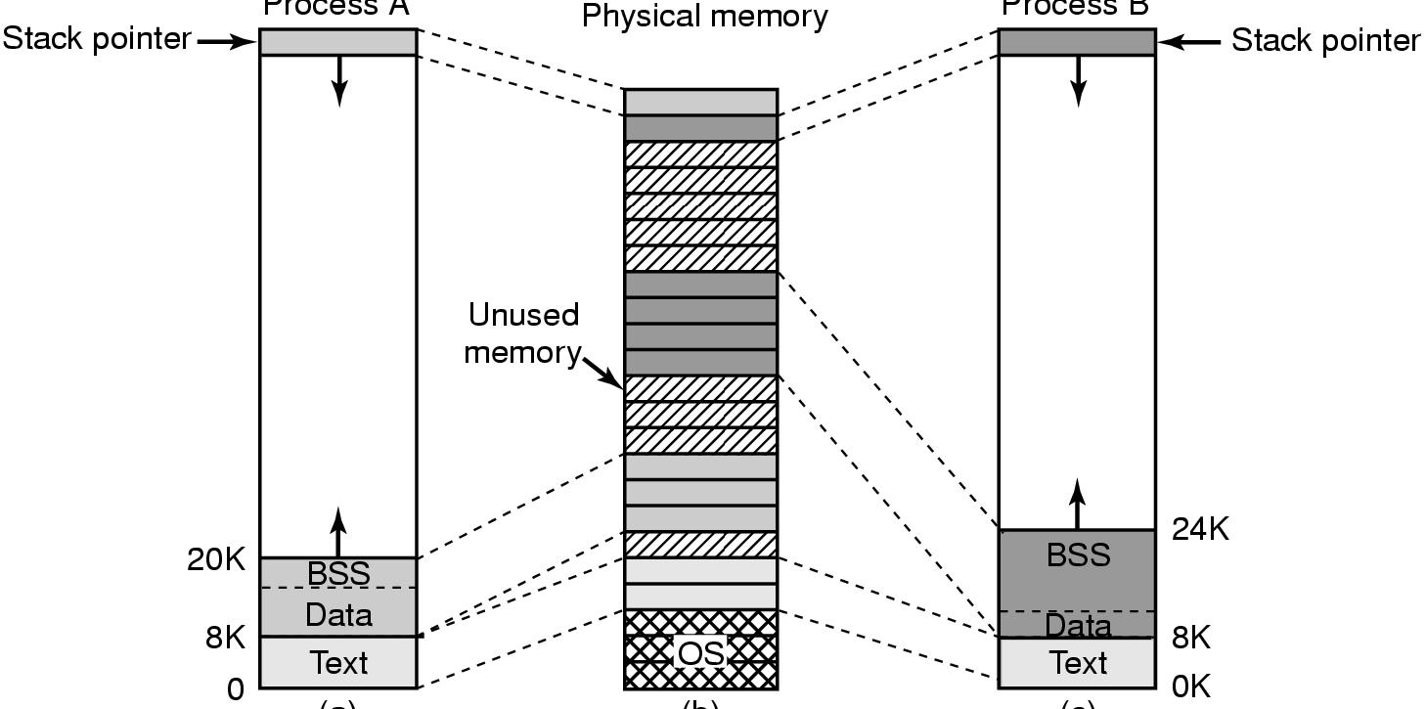
Memory Management in Linux (2)
Figure 10-12. (a) Process A’s virtual address space. (b) Physical memory. (c) Process B’s virtual address space.
Tanenbaum, Modern Operating Systems 3 e, (c) 2008 Prentice-Hall, Inc. All rights reserved. 0-13-6006639

Slide 21
Memory Management in Linux
Text segment: machine instructions
Data segment: storage for all the program’s variables, strings, arrays, and other data
Stack segment: starts at or near the top of the virtual address space
Tanenbaum, Modern Operating Systems 3 e, (c) 2008 Prentice-Hall, Inc. All rights reserved. 0-13-6006639

Slide 22
Physical Memory Management
Each process gets a 3GB of virtual address space for itself, with remaining 1GB for its page tables and other kernel data (32-bit).
The kernel memory resides in low physical memory but mapped in the top 1GB of each process virtual address space.
Tanenbaum, Modern Operating Systems 3 e, (c) 2008 Prentice-Hall, Inc. All rights reserved. 0-13-6006639

Slide 23
Physical Memory Management
Due to idiosyncratic hardware limitations on many systems, not all physical memory can be treated identically, especially with respect to I/O and virtual memory.
Linux distinguishes between the following memory zones:
ZONE DMA and ZONE DMA32: pages that can be used for DMA.
ZONE NORMAL: normal, regularly mapped pages.
ZONE HIGHMEM: pages with high-memory addresses, which are not permanently mapped.
Tanenbaum, Modern Operating Systems 3 e, (c) 2008 Prentice-Hall, Inc. All rights reserved. 0-13-6006639

Slide 24
Physical Memory Management
Main memory in Linux consists of three parts. The first two parts, the kernel and memory map, are pinned in memory (i.e., never paged out).
The rest of memory is divided into page frames, each of which can contain a text, data, or stack
page, a page-table page, or be on the free list.
Tanenbaum, Modern Operating Systems 3 e, (c) 2008 Prentice-Hall, Inc. All rights reserved. 0-13-6006639

Slide 25
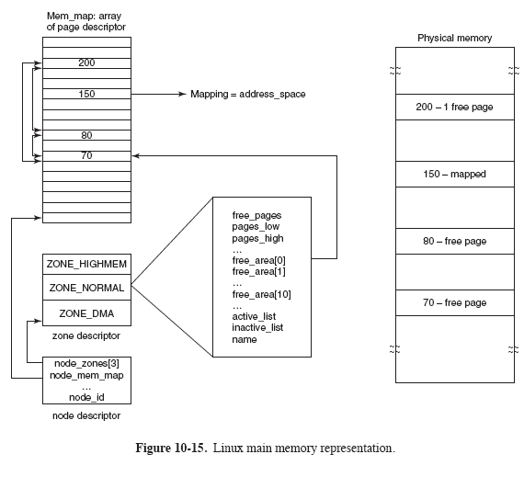
Physical Memory Management
Tanenbaum, Modern Operating Systems 3 e, (c) 2008 Prentice-Hall, Inc. All rights reserved. 0-13-6006639

Slide 26
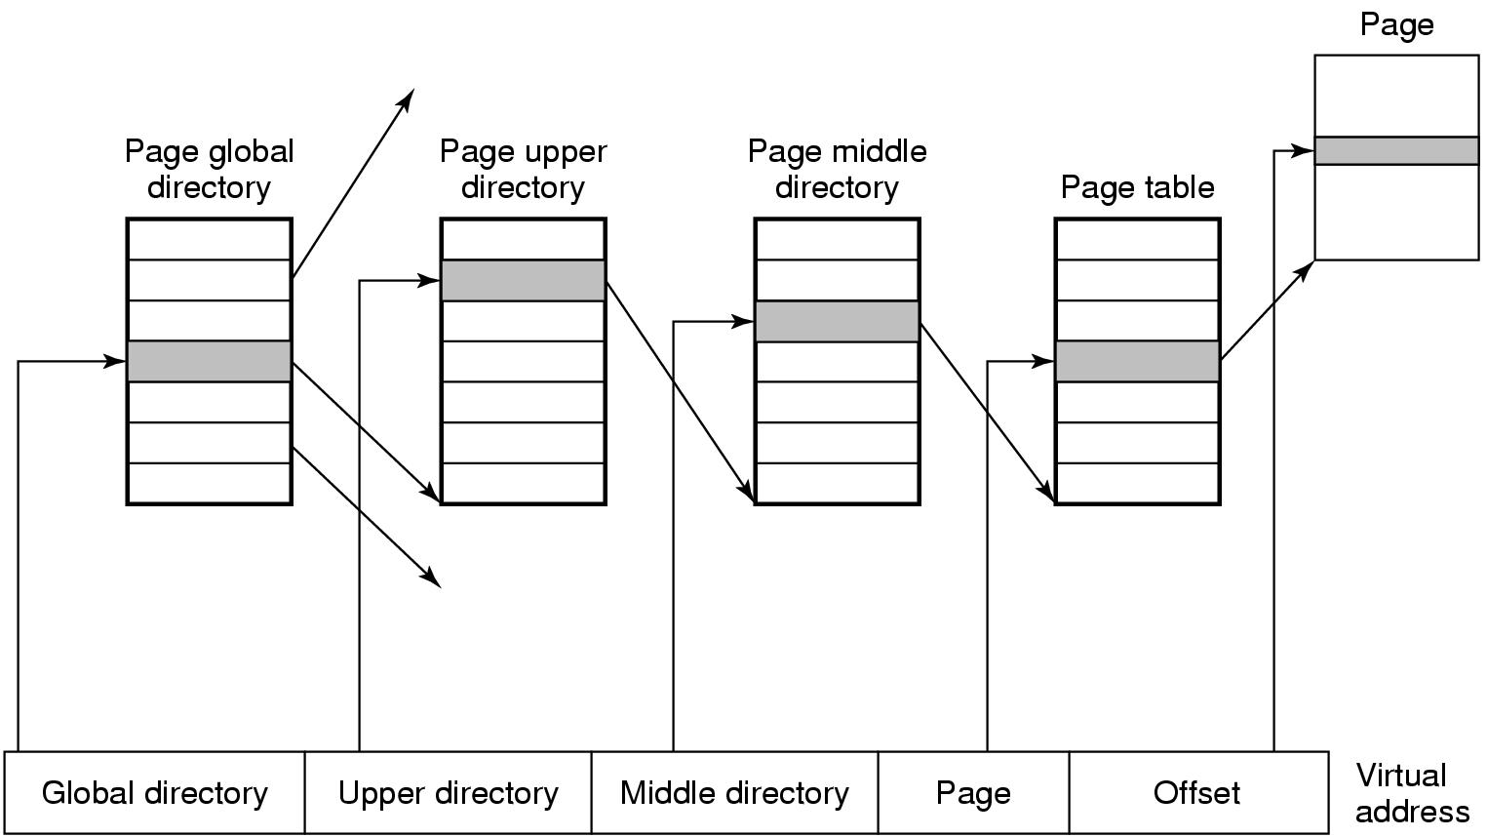
Physical Memory Management (2)
In order for the paging mechanism to be efficient on 32- and 64-bit architecture, Linux uses a four-level paging scheme.
Tanenbaum, Modern Operating Systems 3 e, (c) 2008 Prentice-Hall, Inc. All rights reserved. 0-13-6006639

Slide 27
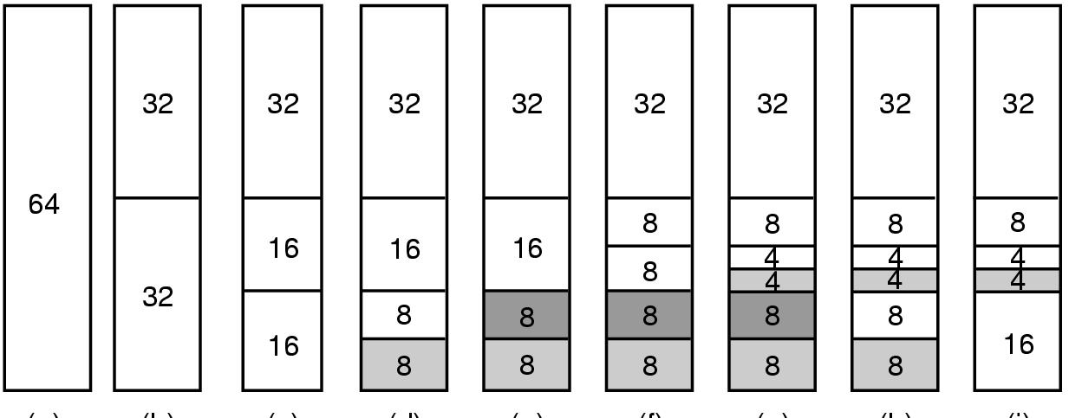
Memory Allocation Mechanisms
Unlike UNIX, Linux supports dynamically loaded modules like device drivers.
It is allowed to acquire an arbitrary-sized piece of memory at will in Linux physical memory management.
Figure 10-17. Operation of the buddy algorithm.
Tanenbaum, Modern Operating Systems 3 e, (c) 2008 Prentice-Hall, Inc. All rights reserved. 0-13-6006639

Slide 28
Physical Memory Management
The virtual address space is divided into homogeneous, contiguous, page-aligned areas or regions. Each area consists of a run of consecutive pages with the same protection and paging properties.
There can be holes in the virtual address space between the areas. Any memory reference to a hole results in a fatal page fault.
The page size is fixed, for example, 4 KB for the Pentium and 8 KB for the Alpha.
Tanenbaum, Modern Operating Systems 3 e, (c) 2008 Prentice-Hall, Inc. All rights reserved. 0-13-6006639

Slide 29
Paging in Linux
A process need not be entirely in memory in order to run. Only need the user structure and the page tables.
The pages of the text, data, and stuck segments are brought in dynamically, one at a time, as they are referenced.
Paging is implemented partly by the kernel and partly by a new process called the page daemon.
Tanenbaum, Modern Operating Systems 3 e, (c) 2008 Prentice-Hall, Inc. All rights reserved. 0-13-6006639

Slide 30
Paging Replacement Algorithm
Linux tries to keep some pages free so that they can be claimed as needed. This pool must be continually replenished.
Tanenbaum, Modern Operating Systems 3 e, (c) 2008 Prentice-Hall, Inc. All rights reserved. 0-13-6006639

Slide 31
Paging Replacement Algorithm
Linux distinguishes between four different types of pages: unreclaimable, swappable, syncable, and discardable.
Unreclaimable (不可回收) pages, which include reserved or locked pages, kernel mode stacks, and the like, may not be paged out.
Swappable pages must be written back to the swap area or the paging disk partition before the page can be reclaimed.
Syncable pages must be written back to disk if they have been marked as dirty.
Discardable pages can be reclaimed immediately.
Tanenbaum, Modern Operating Systems 3 e, (c) 2008 Prentice-Hall, Inc. All rights reserved. 0-13-6006639

Slide 32
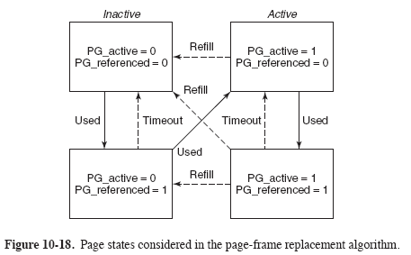
Paging Replacement Algorithm
Tanenbaum, Modern Operating Systems 3 e, (c) 2008 Prentice-Hall, Inc. All rights reserved. 0-13-6006639

Slide 33
I/O in Linux
I/O devices are made to look like files and are accessed as such with the same read and write system calls.
Linux integrate the devices into the file system as what are called special files.
/dev/hd1 disk
/dev/lp printer cp file /dev/lp
/dev/net network
Tanenbaum, Modern Operating Systems 3 e, (c) 2008 Prentice-Hall, Inc. All rights reserved. 0-13-6006639

Slide 34
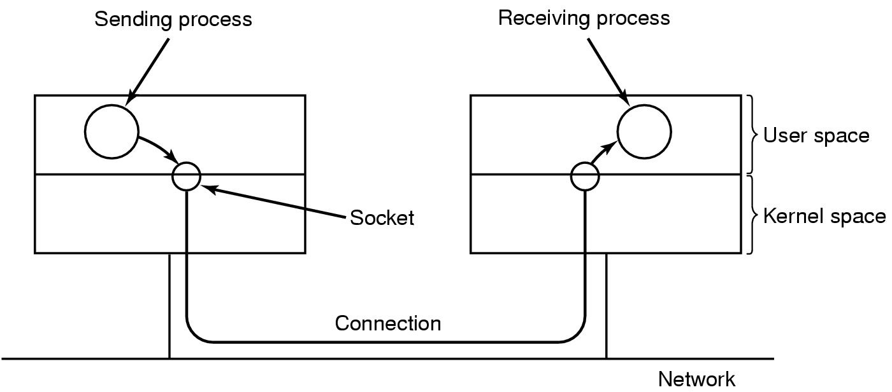
Networking (I/O) (1)
Key concept: socket
Figure 10-19. The uses of sockets for networking.
Tanenbaum, Modern Operating Systems 3 e, (c) 2008 Prentice-Hall, Inc. All rights reserved. 0-13-6006639

Slide 35
Networking (2)
Each socket supports a particular type of networking. The most common types:
Reliable connection-oriented byte stream.
Reliable connection-oriented packet stream.
Unreliable packet transmission.
Tanenbaum, Modern Operating Systems 3 e, (c) 2008 Prentice-Hall, Inc. All rights reserved. 0-13-6006639

Slide 36
Networking (3)
When a socket is created, one of the parameters specifies the protocol to be used for it.
For reliable byte stream, the most popular protocol is TCP (Transmission Control Protocol).
For unreliable packet-oriented transmission, UDP (User Datagram Protocol) is the usual choice.
Both of these are layered on top of IP (Internet Protocol).
Tanenbaum, Modern Operating Systems 3 e, (c) 2008 Prentice-Hall, Inc. All rights reserved. 0-13-6006639

Slide 37
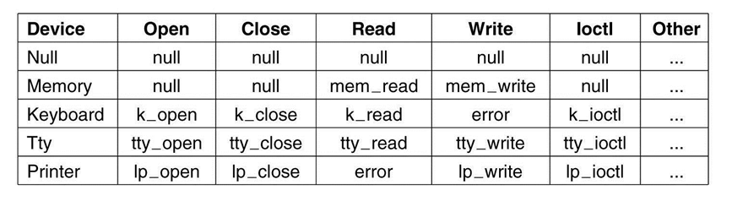
The Major Device Table
Figure 10-21. Some of the file operations supported
for typical character devices.
Tanenbaum, Modern Operating Systems 3 e, (c) 2008 Prentice-Hall, Inc. All rights reserved. 0-13-6006639

Slide 38
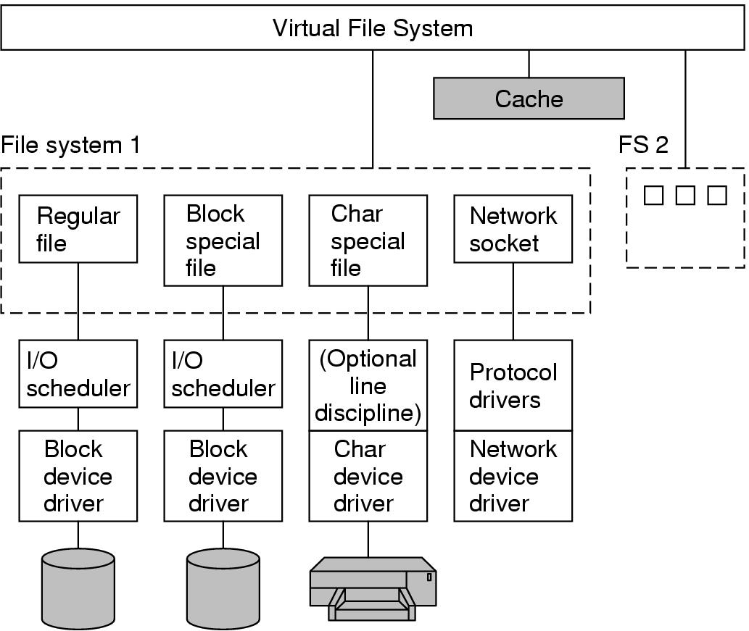
Implementation of
Input/Output in Linux (2)
Figure 10-22. The Linux I/O system showing one file system in detail.
Tanenbaum, Modern Operating Systems 3 e, (c) 2008 Prentice-Hall, Inc. All rights reserved. 0-13-6006639

Slide 39
The Linux File System
The initial Linux file system was the MINIX 1, limited file names to 14 characters and max file size was 64MB.
ext allowed file names of 255 characters and files of 2GB.
ext2 allowed long file names, long files, and better performance.
But Linux supports several dozen file systems using VFS.
Tanenbaum, Modern Operating Systems 3 e, (c) 2008 Prentice-Hall, Inc. All rights reserved. 0-13-6006639

Slide 40
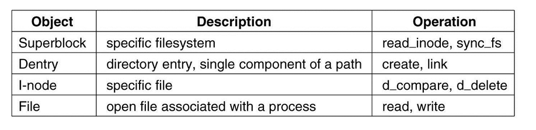
The Linux Virtual File System
VFS (Virtual File System), enable applications to interact with different file systems, implemented on different types of local or remote devices.
Figure 10-30. File system abstractions supported by the VFS.
Tanenbaum, Modern Operating Systems 3 e, (c) 2008 Prentice-Hall, Inc. All rights reserved. 0-13-6006639

Slide 41
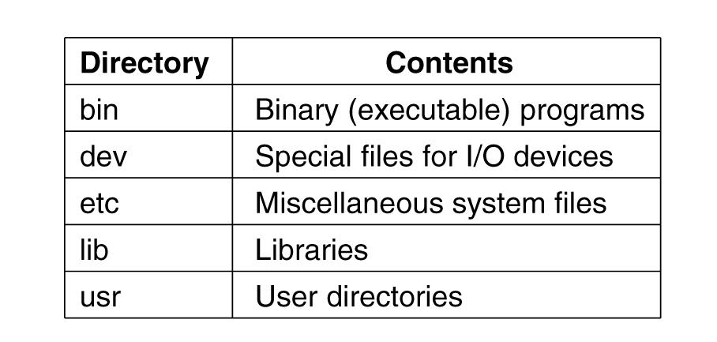
The Linux File System (1)
Figure 10-23. Some important directories
found in most Linux systems.
Tanenbaum, Modern Operating Systems 3 e, (c) 2008 Prentice-Hall, Inc. All rights reserved. 0-13-6006639

Slide 42
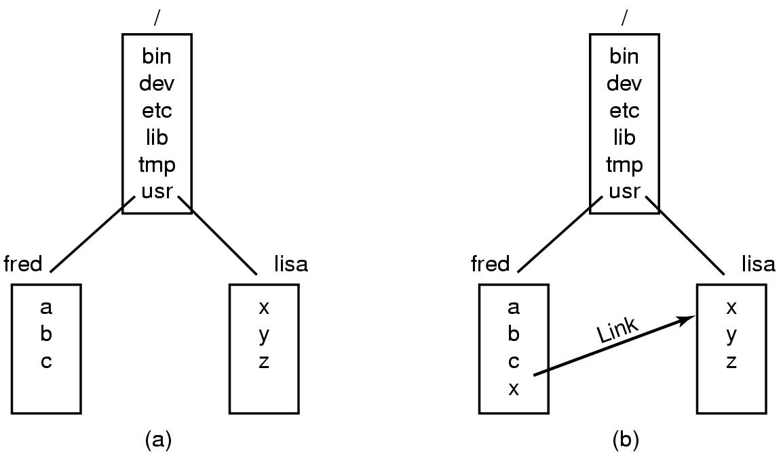
The Linux File System (2)
Figure 10-24. (a) Before linking. (b) After linking.
Tanenbaum, Modern Operating Systems 3 e, (c) 2008 Prentice-Hall, Inc. All rights reserved. 0-13-6006639

Slide 43
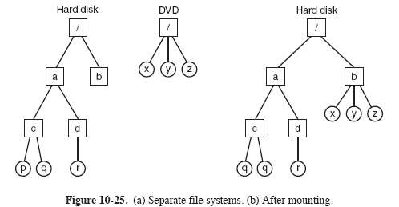
The Linux File System (3)
Tanenbaum, Modern Operating Systems 3 e, (c) 2008 Prentice-Hall, Inc. All rights reserved. 0-13-6006639

Slide 44
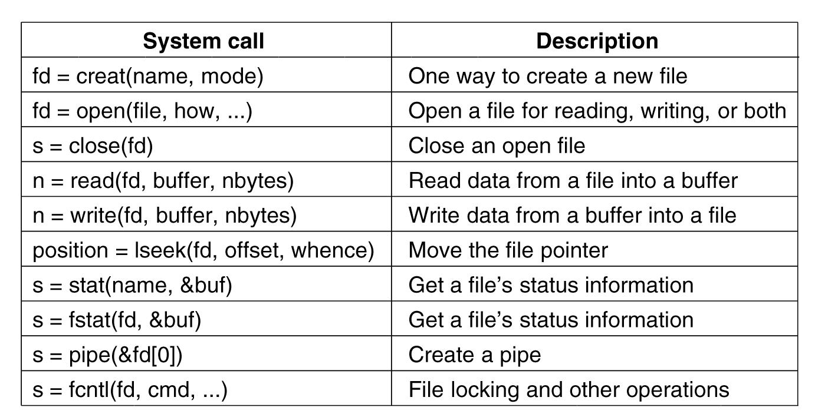
File System Calls in Linux (1)
Figure 10-27. System calls relating to files.
Tanenbaum, Modern Operating Systems 3 e, (c) 2008 Prentice-Hall, Inc. All rights reserved. 0-13-6006639

Slide 45
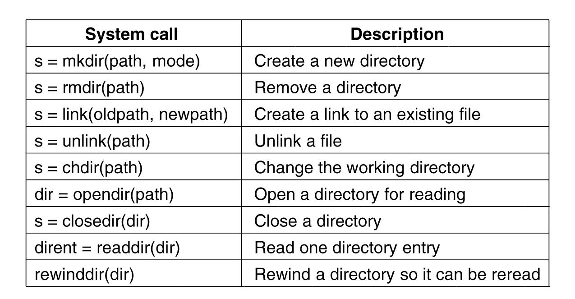
File System Calls in Linux (2)
Figure 10-29. System calls relating to directories.
Tanenbaum, Modern Operating Systems 3 e, (c) 2008 Prentice-Hall, Inc. All rights reserved. 0-13-6006639

Slide 46
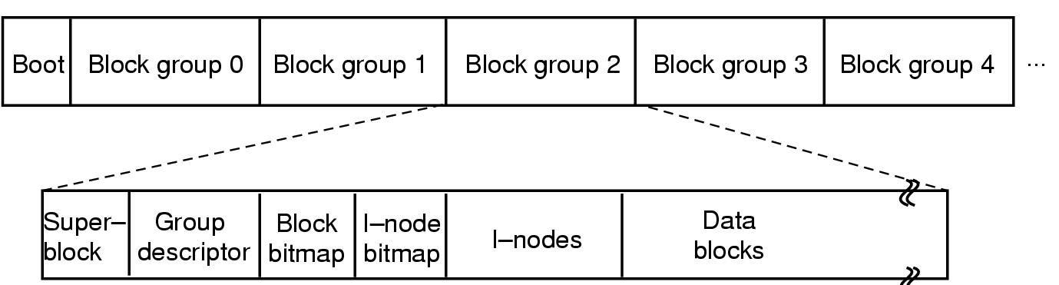
The Linux Ext2 File System (1)
Figure 10-31. Disk layout of the Linux ext2 file system.
Tanenbaum, Modern Operating Systems 3 e, (c) 2008 Prentice-Hall, Inc. All rights reserved. 0-13-6006639

Slide 47
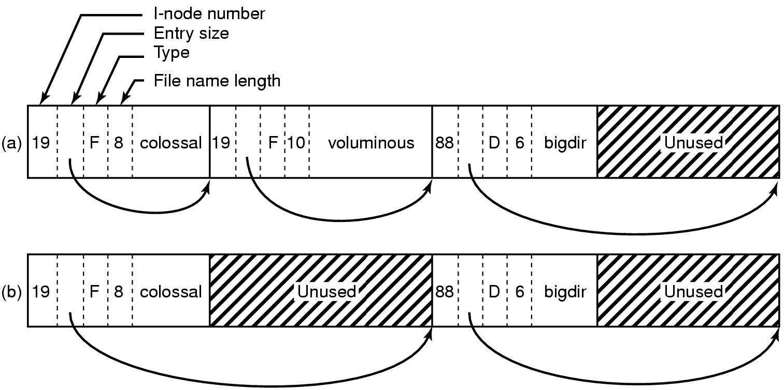
The Linux Ext2 File System (2)
Figure 10-32. (a) A Linux directory with three files. (b) The same directory after the file voluminous has been removed.
Tanenbaum, Modern Operating Systems 3 e, (c) 2008 Prentice-Hall, Inc. All rights reserved. 0-13-6006639

Slide 48
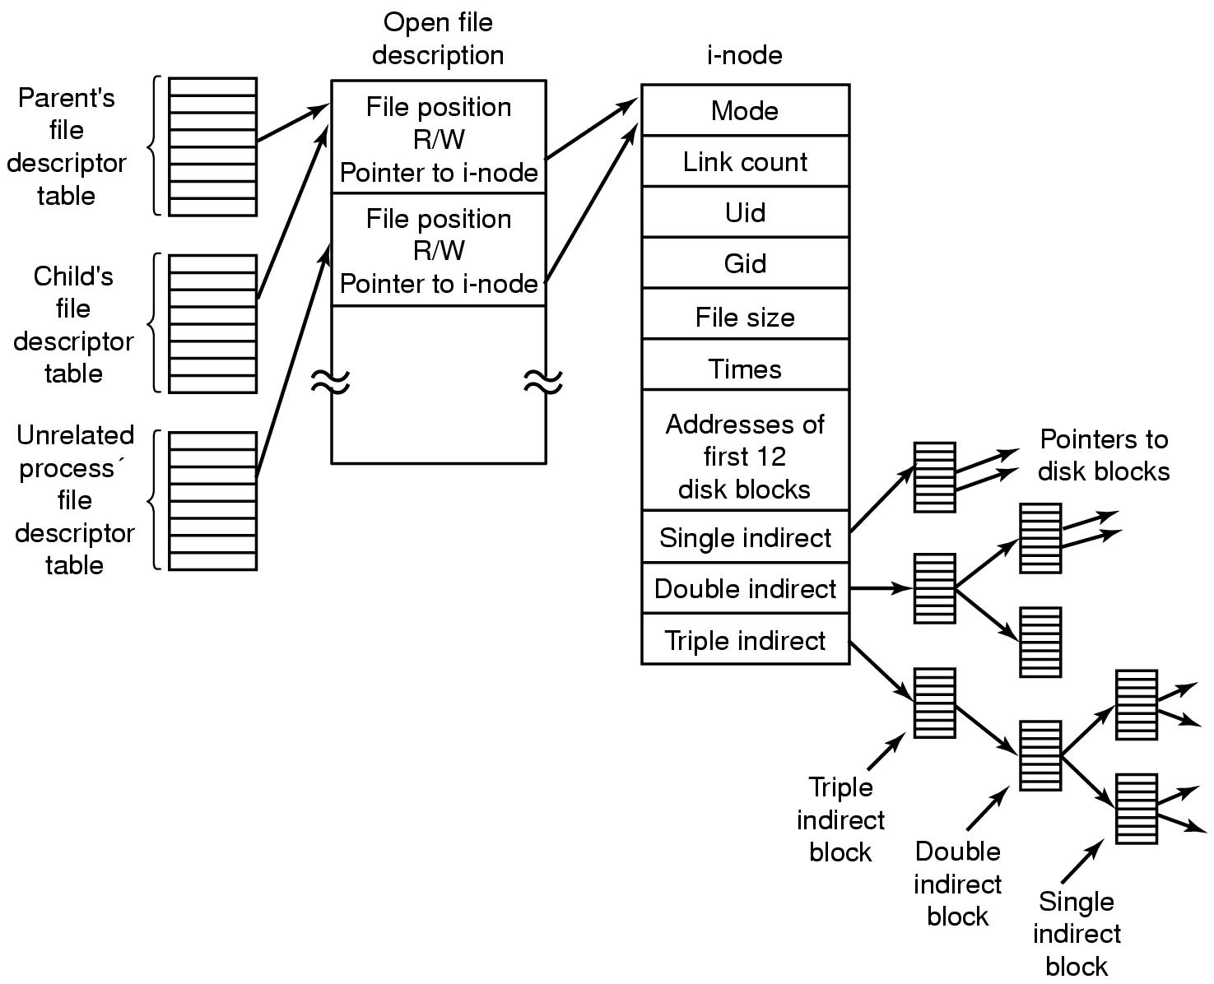
The Linux Ext2 File System (3)
Figure 10-34. The relation between the file descriptor table, the open file description table, and the i-node table.
Tanenbaum, Modern Operating Systems 3 e, (c) 2008 Prentice-Hall, Inc. All rights reserved. 0-13-6006639

Slide 49
/proc file system
For every process in the system, a directory is created in /proc, it contains information about:
command line
environment strings
signal masks
…
Tanenbaum, Modern Operating Systems 3 e, (c) 2008 Prentice-Hall, Inc. All rights reserved. 0-13-6006639

Slide 50
NFS, Network File System
NFS, used to join the file systems on separate computers into one logical whole.
Basic idea: allow an arbitrary collection of clients and servers to share a common file system.
Tanenbaum, Modern Operating Systems 3 e, (c) 2008 Prentice-Hall, Inc. All rights reserved. 0-13-6006639

Slide 51
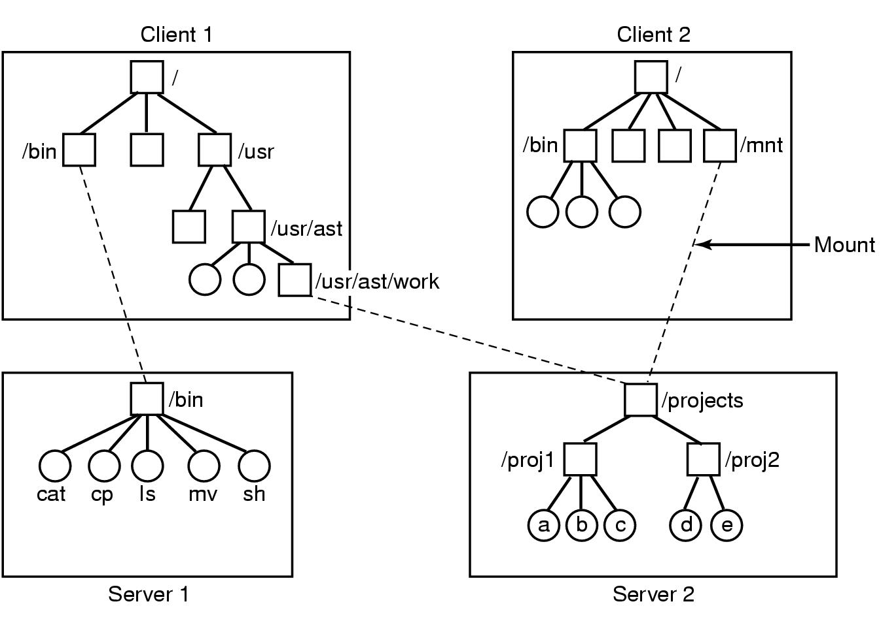
NFS Protocols
Figure 10-35. Examples of remote mounted file systems. Directories shown as squares, files shown as circles.
Tanenbaum, Modern Operating Systems 3 e, (c) 2008 Prentice-Hall, Inc. All rights reserved. 0-13-6006639

Slide 52
NFS protocol
Aim to support a heterogeneous system 异构系统, it is essential that the interface between the clients and serves be well defined.
Two client-server protocols:
Mounting handle
Directory and file access
Tanenbaum, Modern Operating Systems 3 e, (c) 2008 Prentice-Hall, Inc. All rights reserved. 0-13-6006639

Slide 53
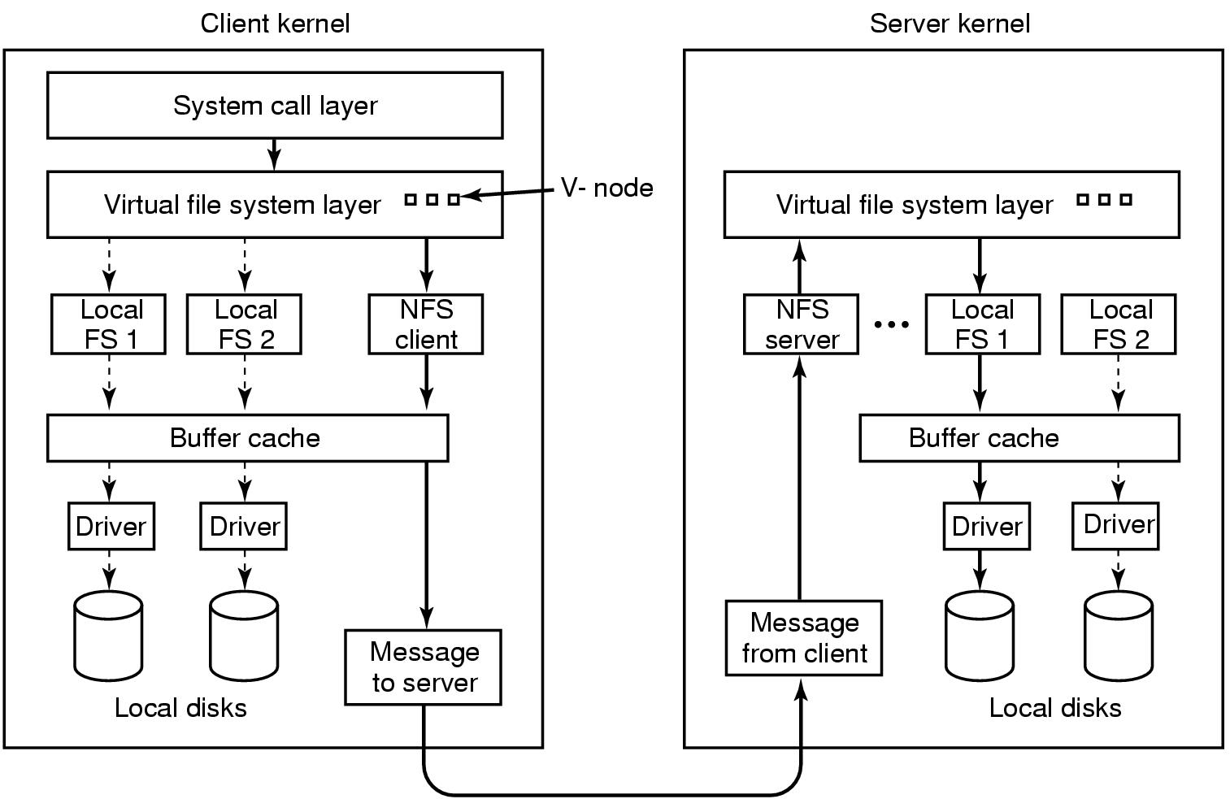
NFS Implementation
Figure 10-36. The NFS layer structure
Tanenbaum, Modern Operating Systems 3 e, (c) 2008 Prentice-Hall, Inc. All rights reserved. 0-13-6006639

Slide 54
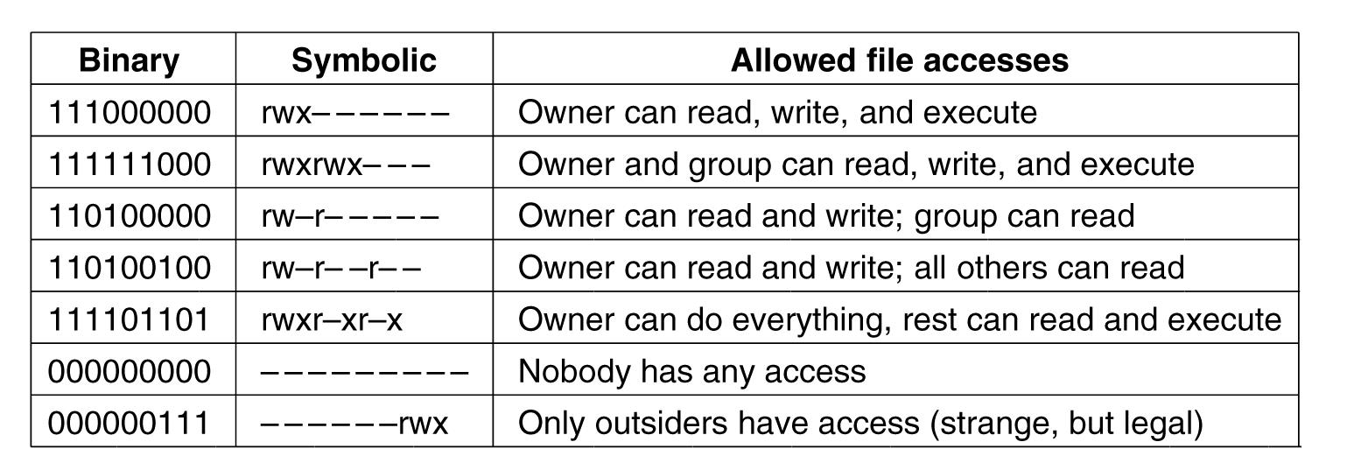
Security In Linux
Each process carries the UID and GID of its owner.
Figure 10-37. Some example file protection modes.
Tanenbaum, Modern Operating Systems 3 e, (c) 2008 Prentice-Hall, Inc. All rights reserved. 0-13-6006639

Slide 55
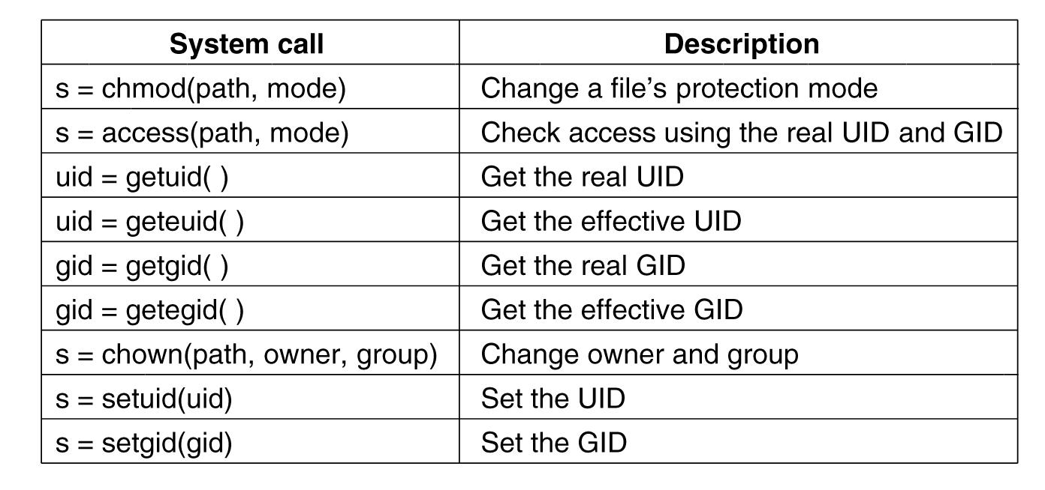
Security System Calls in Linux
Figure 10-38. system calls relating to security.
Tanenbaum, Modern Operating Systems 3 e, (c) 2008 Prentice-Hall, Inc. All rights reserved. 0-13-6006639

